Slide 1
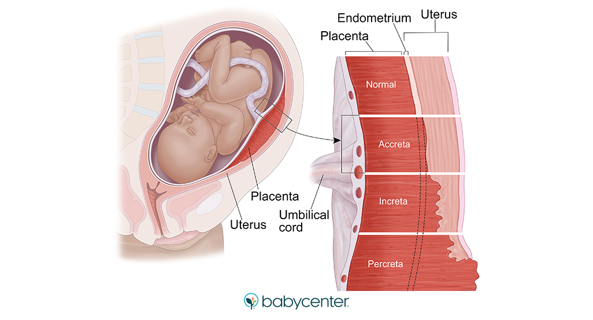
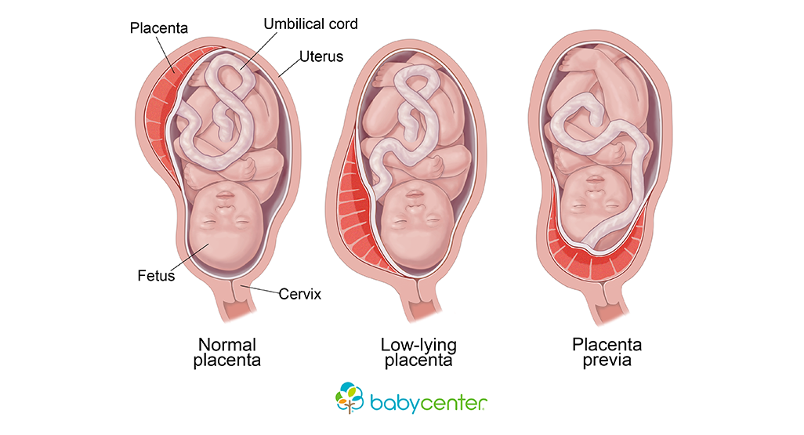
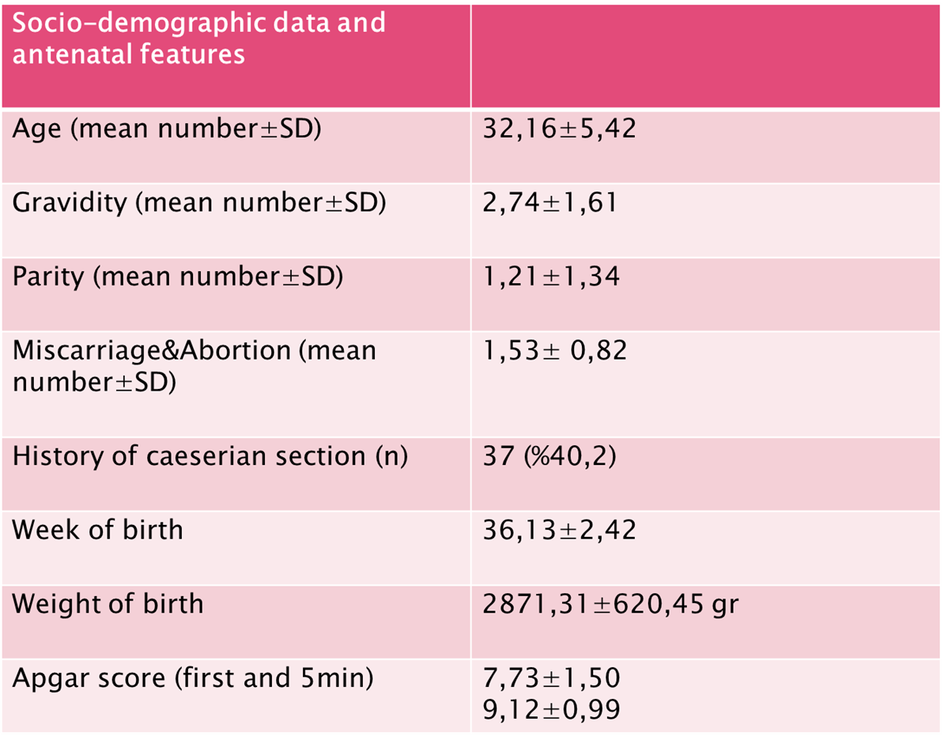
İpek Pekel¹, Pakizer Banu Kılıçoğlu Dane²
¹Bezmialem Vakıf University, Faculty of Medicine, Istanbul, Turkey.
²Bezmialem Vakıf University, Faculty of Medicine, Bezmialem Vakıf University Department of Obstetrics and Gynecology, Istanbul, Turkey.
Placenta Previa Risk Factors and The Relevance Between Ultrasound Findings and Hysterectomy Incidence
INTRODUCTION
Placenta previa is a condition in which the placenta is attached to the lower uterine segment and completely or partially covers the internal cervix blocking servical os and causing inability for normal vaginal birth. Reported rates of placenta previa are between 0.3 and 0.8%. Most typical clinic feature for placenta previa is painless, mostly recurring, spontaneous vaginal bleeding at the end of second trimester. Etiology of placenta previa is although not yet certain, maternal age, cigarette, parity, gravity, miscarriage, male fetüs, abortion, cesarean section are thought to be contributing factors. As parallels with increased cesaeran section, placenta previa incidence also increases. In this study we attempted to see the relationship between antenatal ultrasound and hysterectomy.
MATERIALS AND METHODS
At least 80 cases of placenta previa who applied Bezmialem Vakıf University Hospital polyclinic between 2010-2020 were studied. The risk factors that were studied are as follows: Maternal age, parity, gravity, miscarriage, abortion, birth weight, the week of birth, apgar score, sex of the fetus. We estimated the effects of these risk factors by calculating mean numbers. As result of hysterectomies, placentas were classified by invasion degree of the placenta layers as placenta percreata, increata, accreata. Use of bleeding protective methods during surgery, antepartum bleeding, bledder invasion of the placenta and the sex of fetus were also studied.
RESULTS
92 placenta previa patient were studied.%30 of the patients had antepartum bleeding. One of three patient was over 35 years. Only in 8 patient uterine invasion was detected by antenatal ultrasound examinations and 4 of them underwent hysterectomy. In 26 patient uterine invasion were seen during surgery and 18 of them underwent hysterectomy, rest of them had bleeding preventer methods such as uterine and hypogactric artery ligation. Bledder invasion have occured in 7 patients in total. Only in 3 patient placental detachment were seen.
Pathological classification showed out of 18 patients who went under hysterectomy, 5 had acreata, 4 had percreata and 9 had increata which constitutes %50 of them. %80 patients with placenta percreata and bleeder invasion had gone into more than three cesaeran sections which strengthens the relationship between uterine wall damage and abnormal placental invasion. %62 of the patients had male fetus.
Placenta accreata %27.7
Placenta percreata %22.2
Placenta increata %50
Invasion findings before operation (antenatal ultrasound)
26 out of 92
Invasion findings during operation
66 out of 92
Non-invasive placenta
8 out of 92
Socio-demographic data and antenatal features are shown.
CONCLUSION
In our study, 8 out of 92 placenta previa cases were detected with antenatal ultrasound invasion findings, 4 of them underwent hysterectomy. Which shows the correlation between antenatal ultrasound invasion findings and hysterectomy incidence is about %50. Also the rate of invasion detection during operation has been found more frequent than antenatal ultrasound.
REFERENCES
1) Mayumi Tsuji, 1 Eiji Shibata,2 David J. Askew,2 Seiichi Morokuma,3 ve ark.(2019) Associations between metal concentrations in whole blood and placenta previa and placenta accreta: the Japan Environment and Children’s Study (JECS), Environ Health Prev Med. 2019; 24: 40.
2) Eric Jauniaux, 1 Lene Grønbeck,2 Catey Bunce,3 Jens Langhoff-Roos,4 and Sally L Collins, Epidemiology of placenta previa accreta: a systematic review and meta-analysis, BMJ Open. 2019; 9(11): e031193.
3)Rowe, T. (2014). Placenta Previa. Journal of Obstetrics and Gynaecology Canada, 36(8), 667–668. doi:10.1016/s1701-2163(15)30503-x
4) Artunç Ülkümen B Pala HG Aktenk F Bülbül Baytur Y, Plasenta previa olgularında gebelik sonuçları Pregnancy outcomes in patients with placenta previa, Ege Tıp Dergisi / Ege Journal of Medicine 2014;53(2):88-91 88
5) Dazhi Fan,1,2,* Song Wu,3,* Li Liu,2,4 Qing Xia,2 Wen Wang,1 Xiaoling Guo,a,1 and Zhengping Liub,1. Prevalence of antepartum hemorrhage in women with placenta previa: a systematic review and meta-analysis, Sci Rep. 2017; 7: 40320.
6) Dr. M Matalliotakis,*,1 A Velegrakis,1 GN Goulielmos,2 E Niraki,1 AE Patelarou,3 and I Matalliotakis1, Association of Placenta Previa with a History of Previous Cesarian Deliveries and Indications for a Possible Role of a Genetic Component, Balkan J Med Genet. 2017 Dec; 20(2): 5–9.
Invasion findings during operation
26 out of 92
18 hysterectomy
Rest of them had bleeding preventer methods(ual, hal, baloon tamponade)
Invasion findings before operation
8 out of 92
4 hysterectomy
Rest of them had bleeding preventer methods (ual, hal, baloon tamponade)
Non-invasive placenta
66 out of 92

